Slide 1
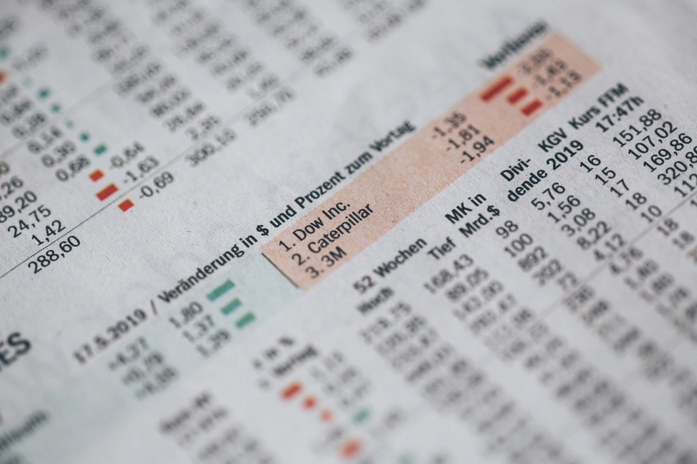
APPLE STOCK PRICE PREDICTION
APPLE STOCK PRICE PREDICTION
INSY695 Enterprise Analytics
Vera Tang Judy Zhu
Amelia Dong Anqi Chen

Slide 2
CONTENT
1
INTRODUCTION
2
AutoML
3
RNN
4
FUTURE RESEARCH

Slide 3
WHY LIVE STOCK PRICE PREDICTION
Optimize stock trading decisions.

Slide 4

INTRODUCTION
Fundamental Analysis
Concerned with the company that underlies the stock itself.
Evaluate a company’s past performance as well as the credibility of its account.
INTRODUCTION
Technical Analysis/Charting
“In the stock market, there are countless strategies for making a buck … … but the greatest trading strategy of all - were it possible – would be to simply learn how much a particular asset will, in the near future, be valued by everybody else in the market.”
Seek to determine the future price of a stock based on the trends of the past price alone.
Techniques: candle stick patterns, exponential moving average
Machine Learning
Use of Artificial Neural Networks (ANNs) and Genetic Algorithms (GA)

Slide 5

Method 1: H2O AutoML
Time series data preprocessing:

Slide 6
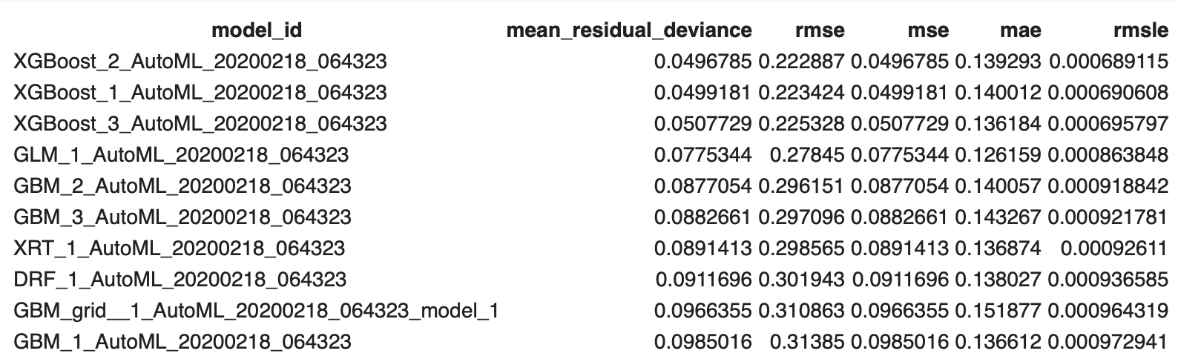
Method 1: H2O AutoML

Slide 7
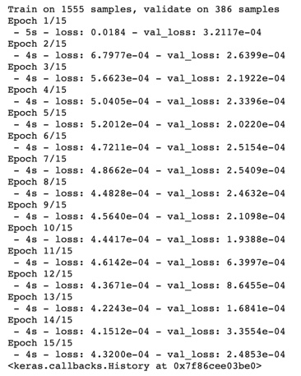
Method 2: RNN
WHY
Time series analysis
PROBLEM
Vanishing gradient problem
LSTM
Improvement on simple RNN

Slide 8
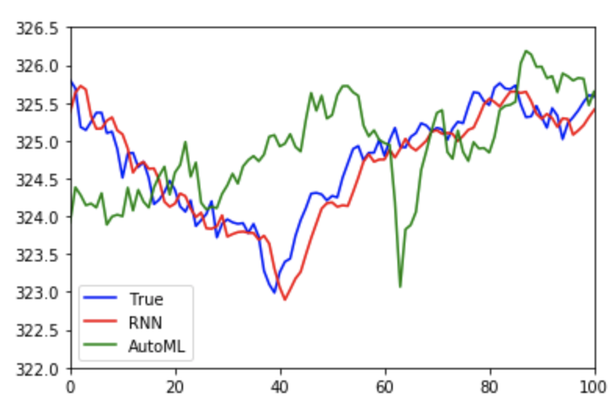
Model Comparison

Slide 9

Word Trading Data
API
Recurrent
Neural Network
OUTPUT
Real time data and real time output

Slide 10

LIVE DEMO

Slide 11
FUTURE RESEARCH
Build trading program.
Improve model accuracy.

Slide 12

Q&A

